Slide 1


Unlocking Insights: Analyzing Northwind Sales Data through Capstone Project

Slide 2

Introduction
Welcome to the Capstone Project on Ananlysing Northwind Sales Data. This presentation will showcase the process of unlocking valuable insights from the sales data through advanced analytics and visualization techniques.

Slide 3

Understanding the NorthWind Dataset
The Northwind dataset is a comprehensive source of sales data, containing information on products, customers, orders, and sales performance. By delving into this dataset, we aim to extract meaningful patterns
and trends.

Slide 4
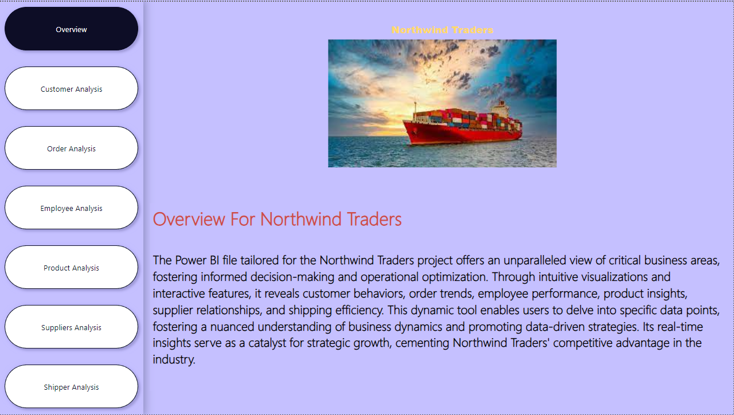
OVERVIEW

Slide 5
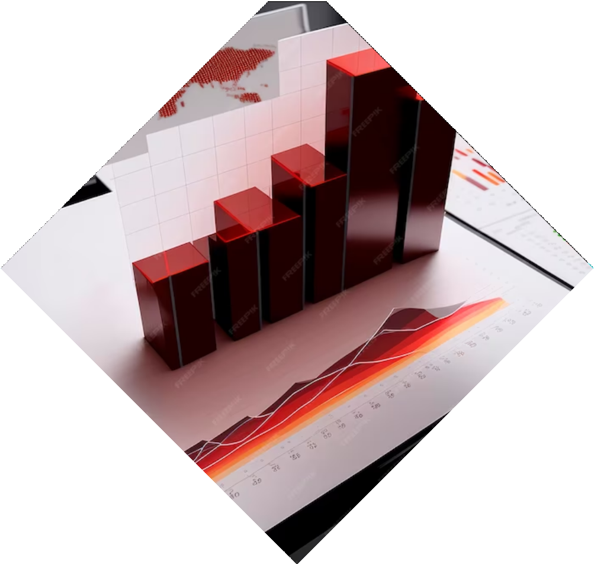
Exploratory Data Analysis
Through Exploratory Data Analysis (EDA), we will delve into the dataset to understand the distribution of sales, identify outliers, and uncover potential correlations. This process will provide a foundation for deeper analysis.

Slide 6
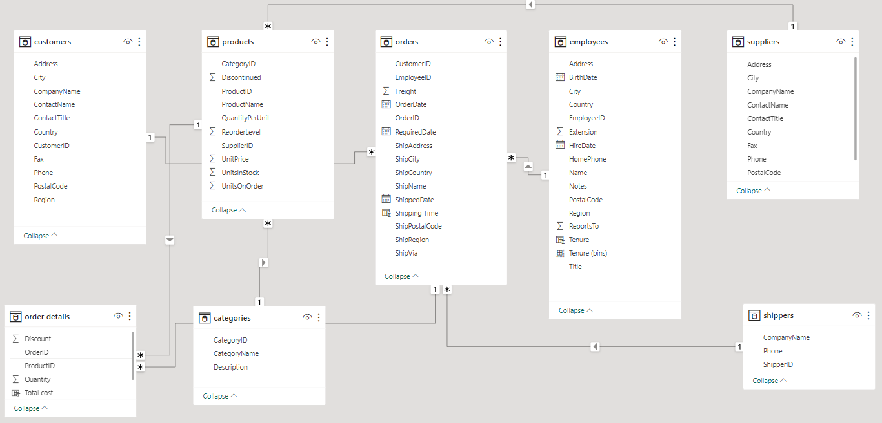
ER DIAGRAM

Slide 7
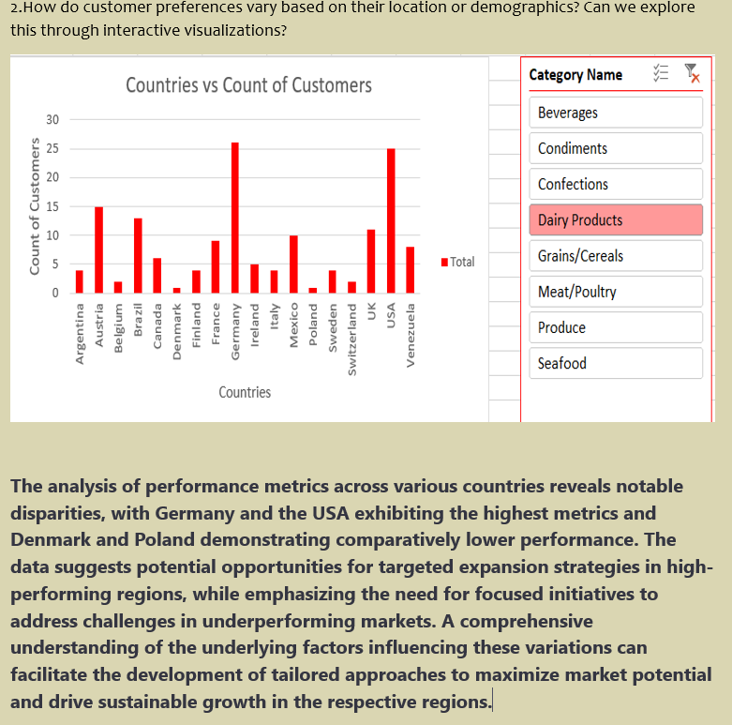
EDA PROBLEM

Slide 8
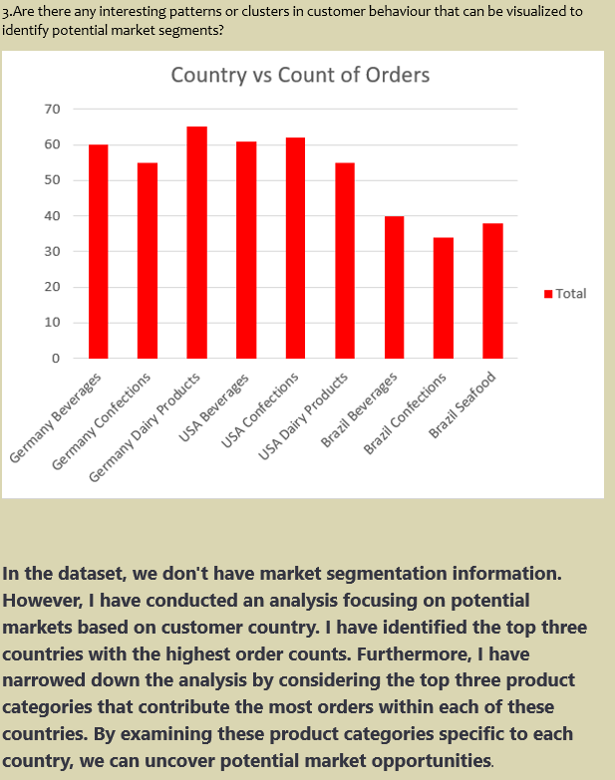

Slide 9
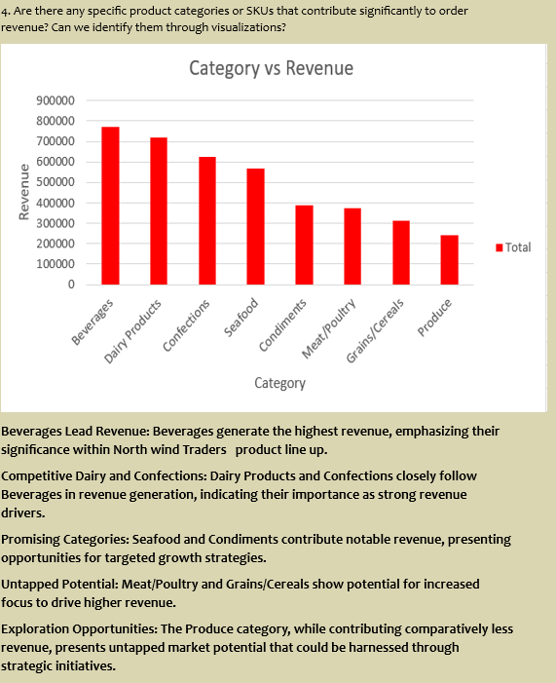

Slide 10
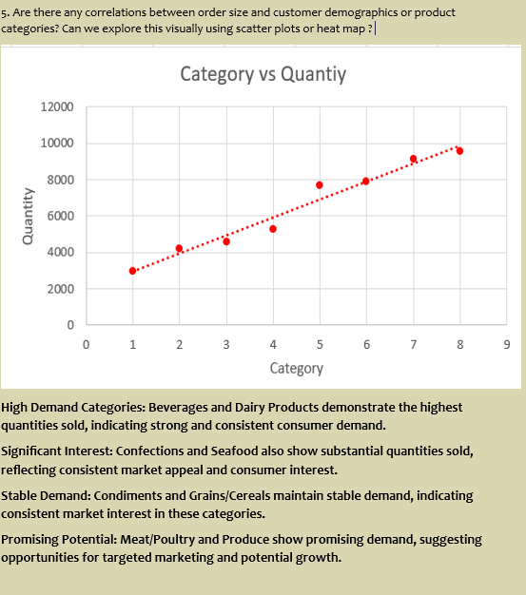

Slide 11
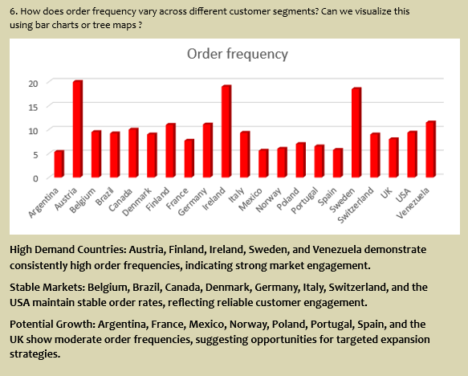

Slide 12
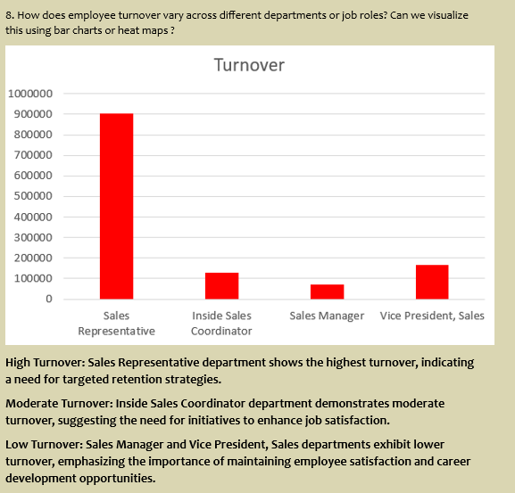

Slide 13
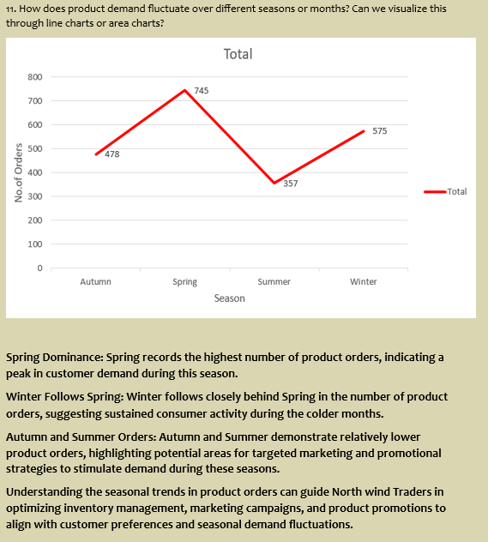

Slide 14
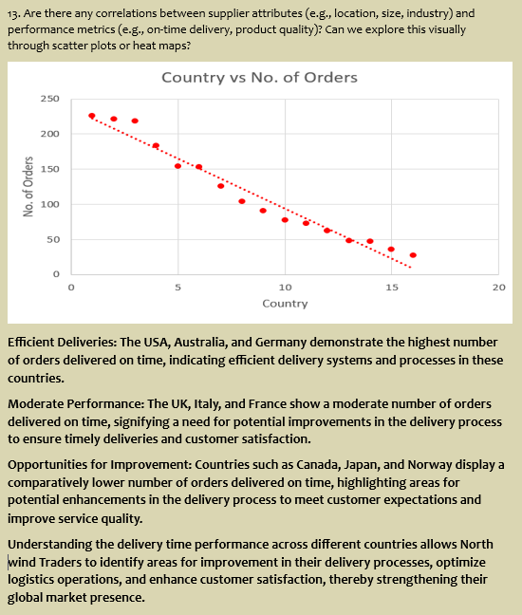

Slide 15
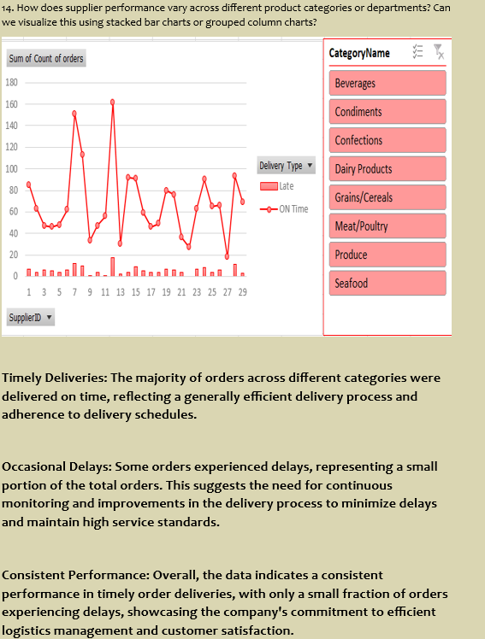

Slide 16
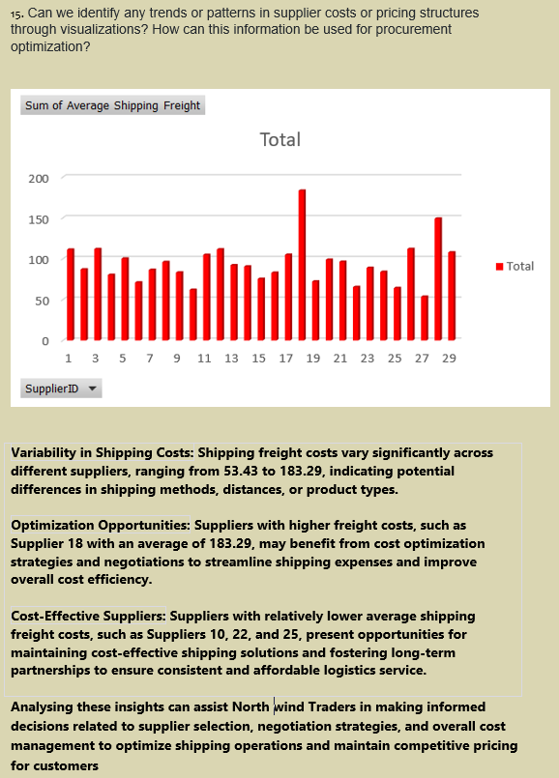

Slide 17
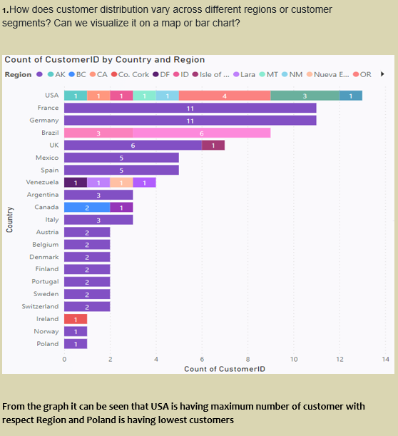
POWER BI PROBLEM

Slide 18
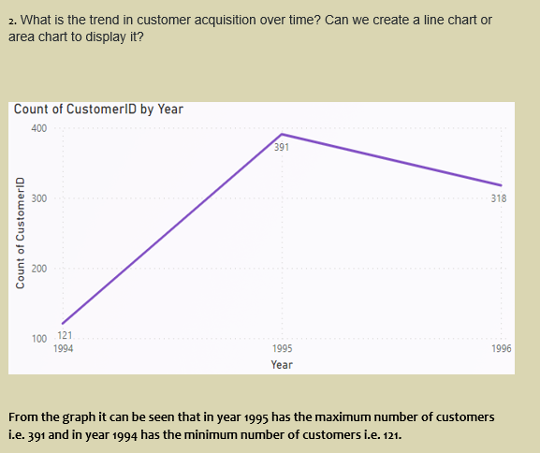

Slide 19
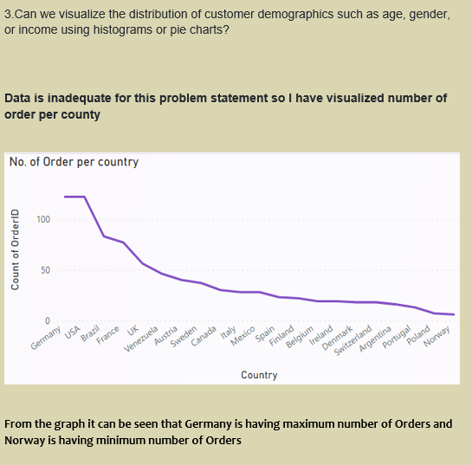

Slide 20
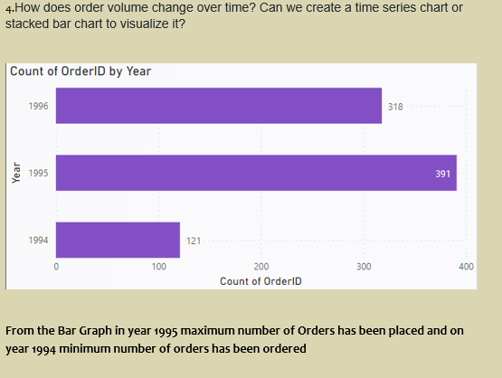

Slide 21
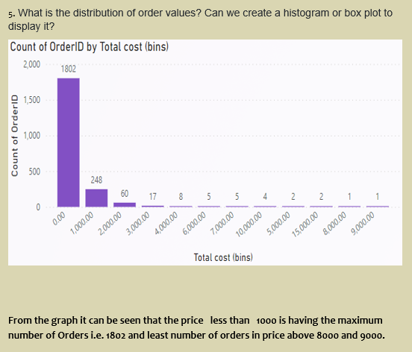

Slide 22
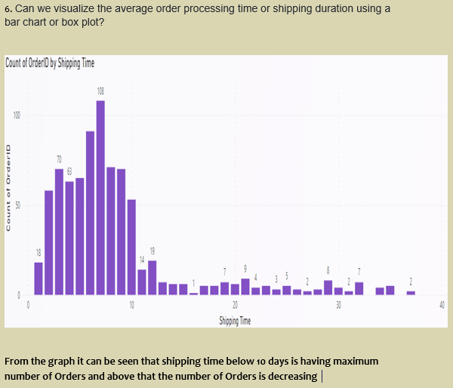

Slide 23
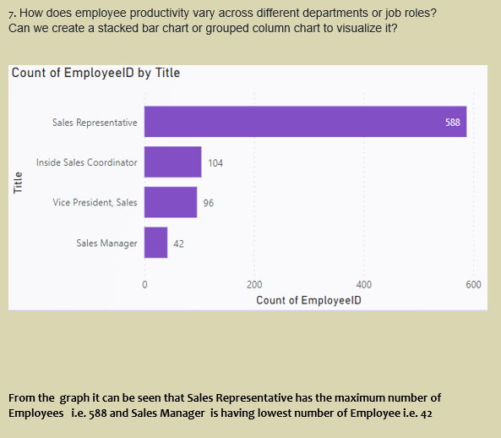

Slide 24
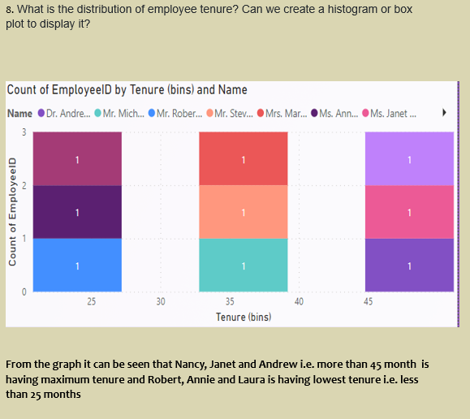

Slide 25
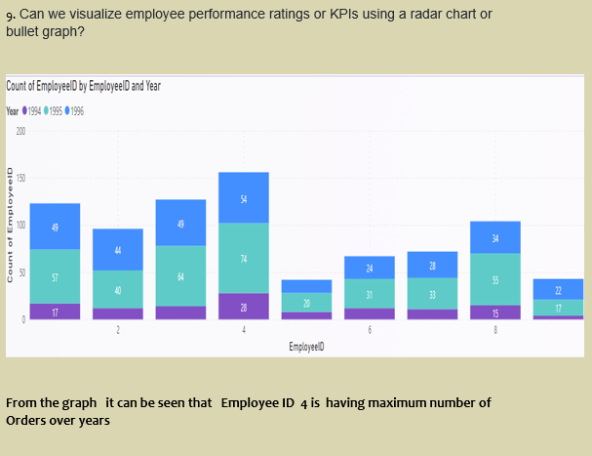

Slide 26
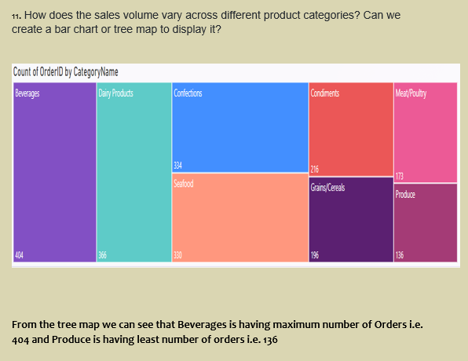

Slide 27
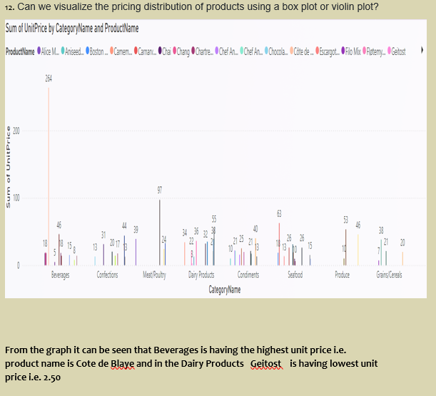

Slide 28
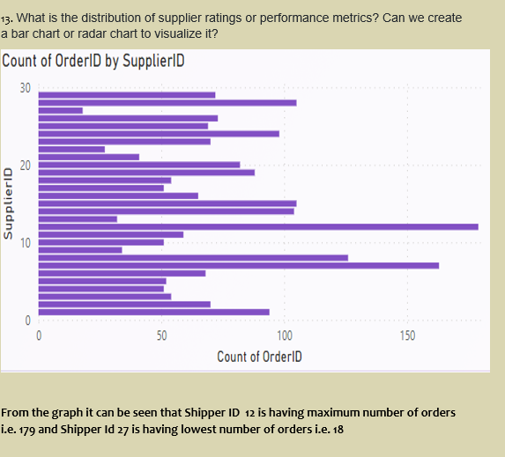

Slide 29
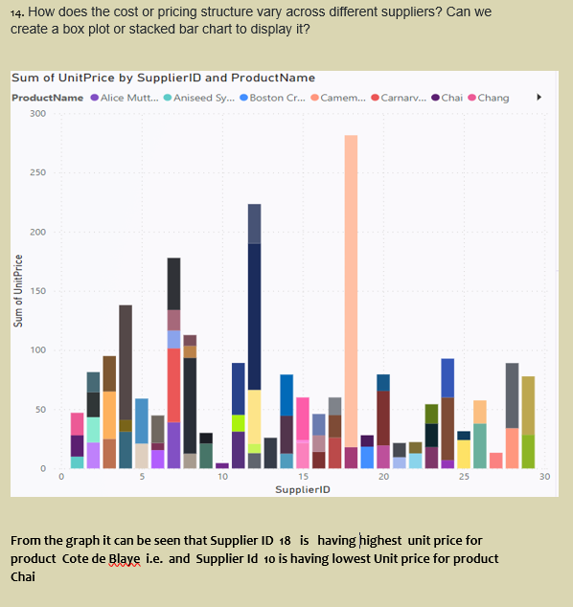

Slide 30
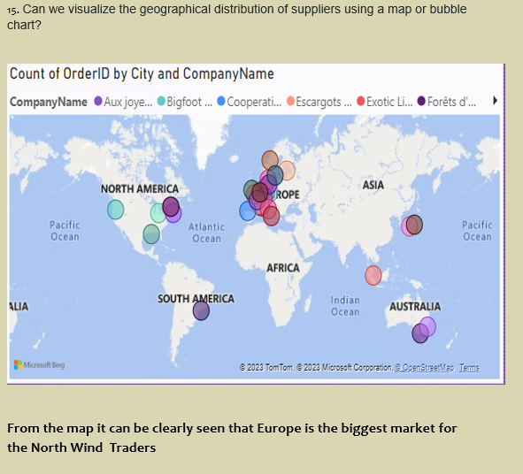

Slide 31
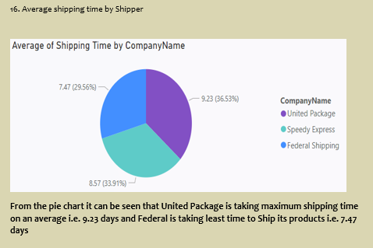

Slide 32
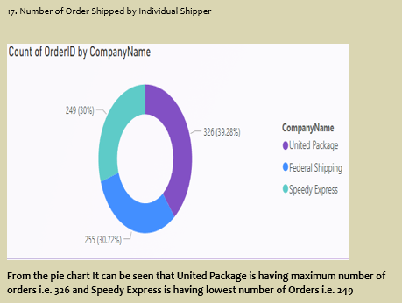

Slide 33
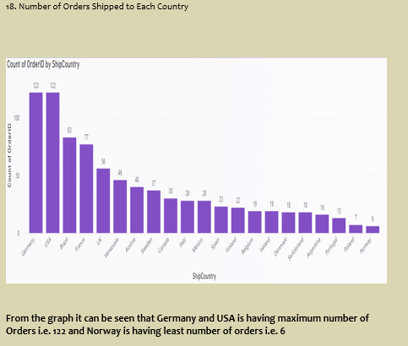

Slide 34
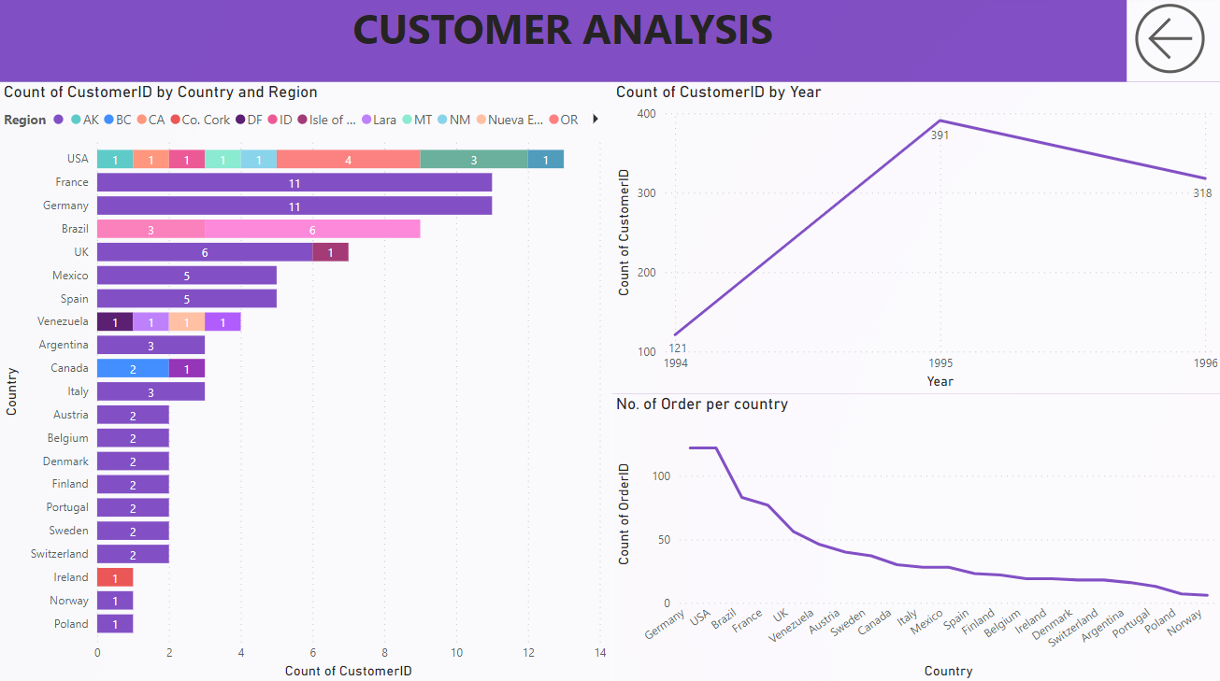
DASHBOARDS

Slide 35
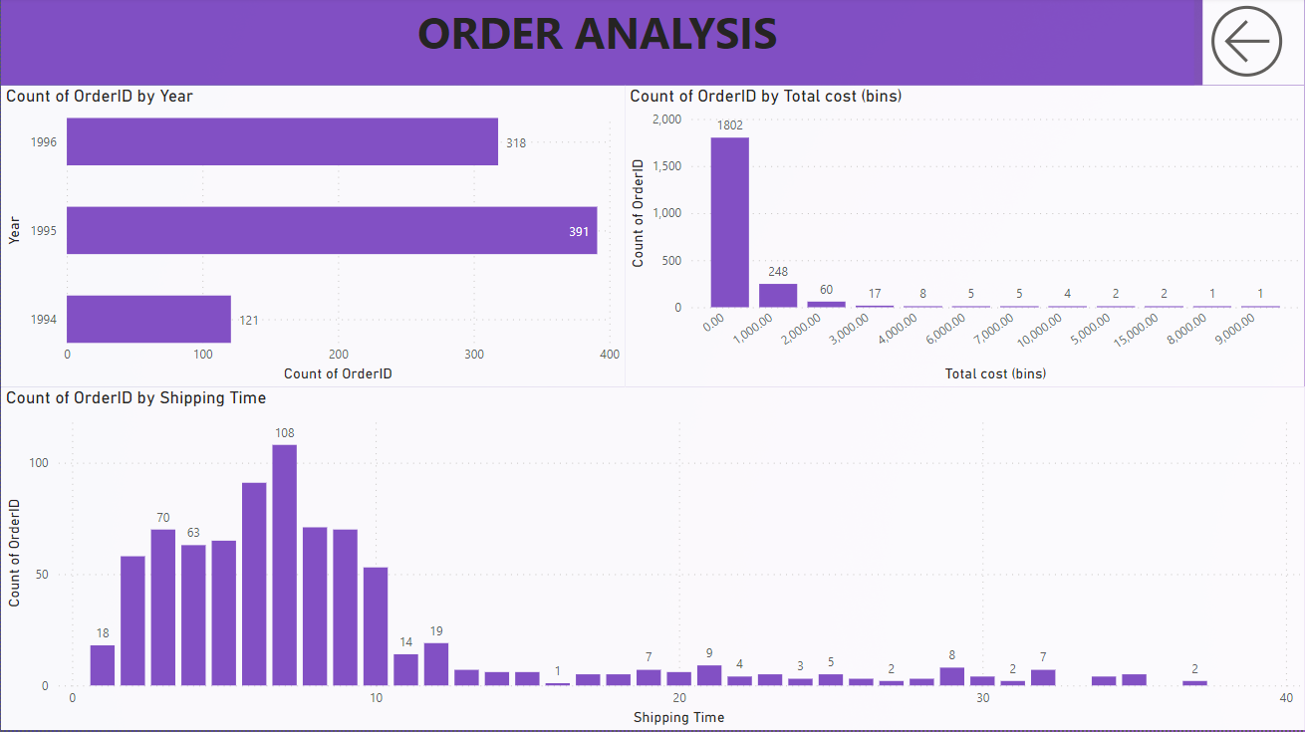

Slide 36
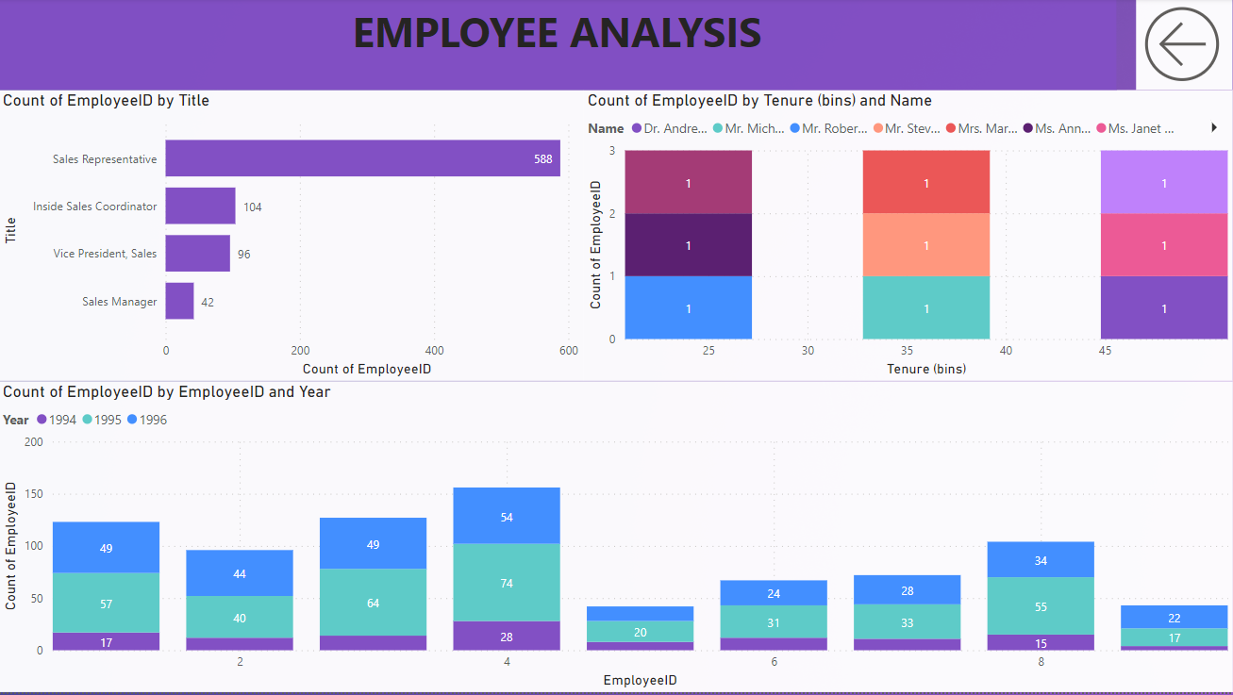

Slide 37
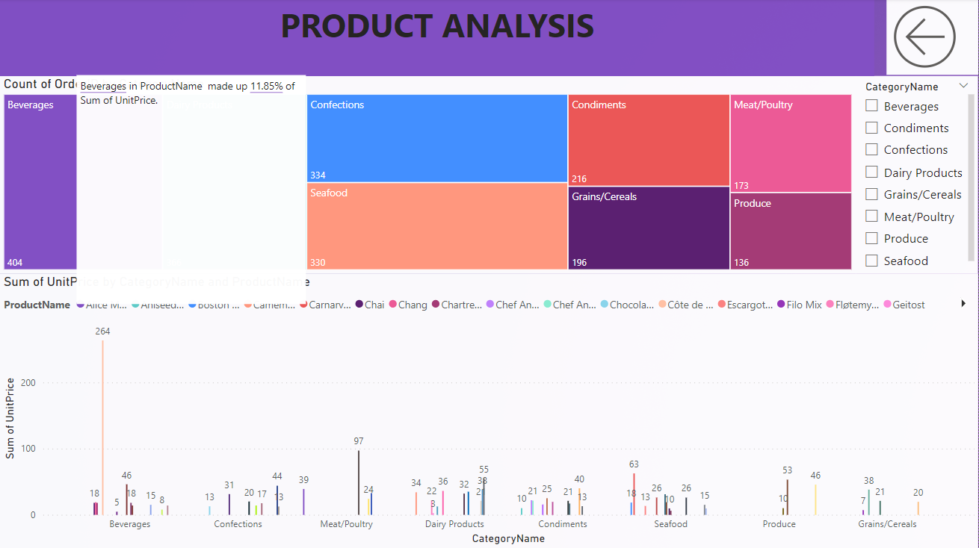

Slide 38
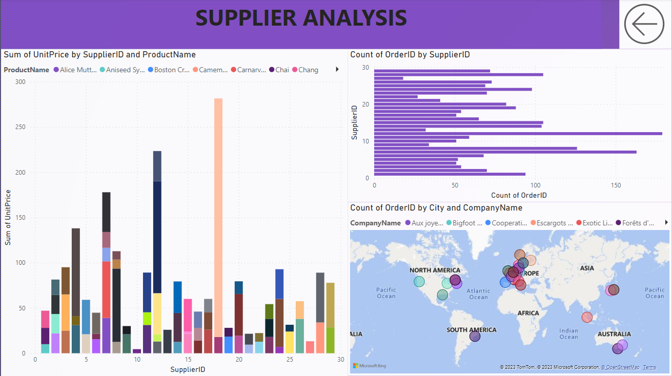

Slide 39
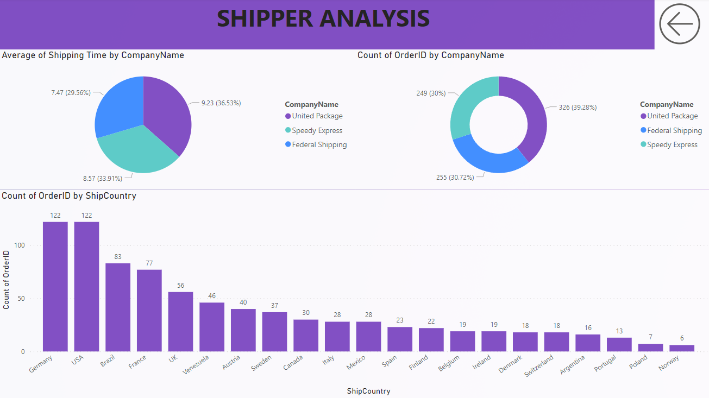

Slide 40
Conclusion
In conclusion, the Capstone Project has provided invaluable experience in leveraging data analysis techniques to derive actionable insights from the Northwind sales data. This project underscores the importance of data-driven decision-making in driving business success.

Slide 41
Thanks!
ABHISHEK KUMAR YADAV
abhishek.1998.yadav@gmail.com
8884668726

